Slide 1

Reporting For SQL Health
dennis.e.graham@hotmail.com
Linkedin: dennisegraham
Dennis E Graham

Slide 2






SQL Saturday

Slide 3
Resources
SQL 2014: Built in
SQL 2012: http://www.microsoft.com/en-us/download/details.aspx?id=29063
http://www.mssqltips.com/sqlservertip/2670/install-sql-server-2012-performance-dashboard-reports/
SQL 2008: http://blogs.technet.com/b/rob/archive/2010/09/28/hosting-the-performance-dashboard-reports-in-ssrs.aspx
SQL 2005: http://www.microsoft.com/en-us/download/details.aspx?DisplayLang=en&id=22602
Hosting the Performance Dashboard Reports in SSRS http://blogs.technet.com/b/rob/archive/2010/09/28/hosting-the-performance-dashboard-reports-in-ssrs.aspx
Sp_Blitz: http://www.brentozar.com/blitz/documentation/
Perfmon Counters Poster: http://www.quest.com/backstage/images/promotions/SQLServer-Perfmonance-Poster.pdf
Top 20: http://michaeljswart.com/2013/09/my-queries-for-top-20-resource-hogs/
DMV e-book http://www.manning.com/stirk/DMViACH01FREE.pdf
DMV e-book http://download.red-gate.com/ebooks/SQL/eBook_Performance_Tuning_Davidson_Ford.pdf

Slide 4

SQL Generations
6 …………………………………………….……………2000 2005 2008 2012 2014

Slide 5
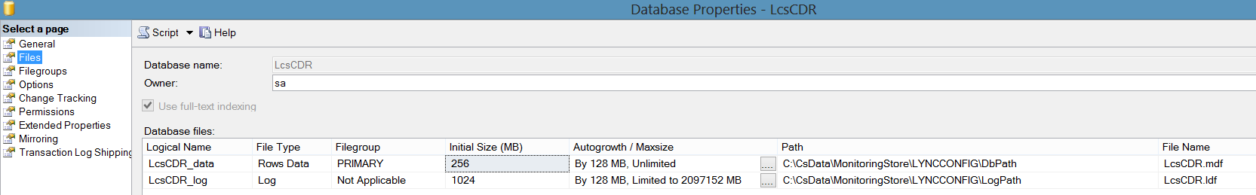

Stone Tablet & Chisel
Use master
SELECT * FROM sys.database_files
master..sp_spaceused

Slide 6
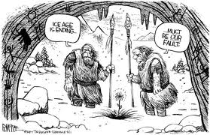
Driving Reason to Evaluation
Responding to a Problem
Newly Delivered
General Checkup
Accidental DBA

Slide 7
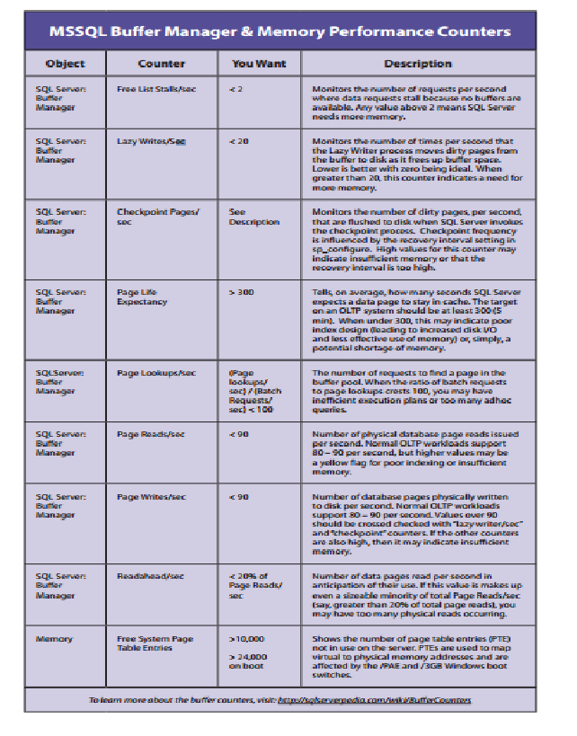
Perfmon Counter Poster
Quest Software
http://www.quest.com/backstage/images/promotions/SQLServer-Perfmonance-Poster.pdf

Slide 8

SQL Standard Reports
SQL Server 2012 Performance Dashboards
PerfMon Reporting
DMV Reporting
Ready Built Scripts
Third-party
Custom
Don’t get caught re-inventing the wheel
Pursuit of SQL Perfection

Slide 9
SQL Server Performance Dashboard
SQL 2014: Builtin
SQL 2012: http://www.microsoft.com/en-us/download/details.aspx?id=29063
http://www.mssqltips.com/sqlservertip/2670/install-sql-server-2012-performance-dashboard-reports/
SQL 2008: http://blogs.technet.com/b/rob/archive/2010/09/28/hosting-the-performance-dashboard-reports-in-ssrs.aspx
SQL 2005: http://www.microsoft.com/en-us/download/details.aspx?DisplayLang=en&id=22602

Slide 10
Server Reports
Configuration Changes History
Schema Changes History
Scheduler Health
Memory Consumption
Activity – All Blocking Transactions
Activity – All Cursors
Activity – Top Cursors
Activity – All Sessions
Activity – Top Sessions
Activity – Dormant SessionsActivity – Top Connections
Top Transactions by Age
Top Trans Blocked Transactions Count
Top Transactions by Locks Count
Performance – Batch Execution Statistics
Performance – Object Exec Statistics
Performance – Top Queries by Avg CPU
Performance – Top Queries by Avg IO
Performance – Top Queries Total CPU
Performance – Top Queries by Total IO
Server Broker Statistics
Transaction Log Shipping Status

Slide 11
Database Reports
Disk Usage
Disk Usage by Top Tables
Disk Usage by Table
Disk Usage by Partition
Backup and Restore Events
All Transactions
All Blocking Transactions
Top Transactions by Age
Top Trans by Blocked Transactions Count
Top Transactions by Locks Count
Top Trans by Blocked Transactions Count
Resource Locking Statistics by Object
Object Execution Statistics
Database Consistency History
Index Usage Statistics
Index Physical Statistics
Schema Changes History
User Statistics
Active Full-Text Catalogs

Slide 12

Miscellaneous Reports
Logins - Login Statistics
Logins - Login Failures
Logins Resource Locking Statistics by Logins
Management - Tasks
Management - Number of Errors
Notification Services - General
Agent - Job Steps Execution History
SQL Server Agent - Top Jobs

Slide 13
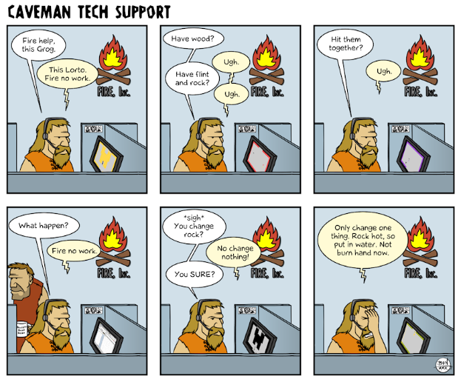
Free Tools Every DBA Should Have
Microsoft Assessment and Planning (MAP) Toolkit
http://technet.microsoft.com/en-us/solutionaccelerators/dd537566.aspx
SP_Blitz
http://BrentOzar.com
Ola Hallergren Index & Backup Maintenance
http://ola.hallengren.com/
SQL Alerts Created Automatically
http://www.sqlskills.com/blogs/glenn/creating-sql-server-agent-alerts-for-critical-errors/

Slide 14
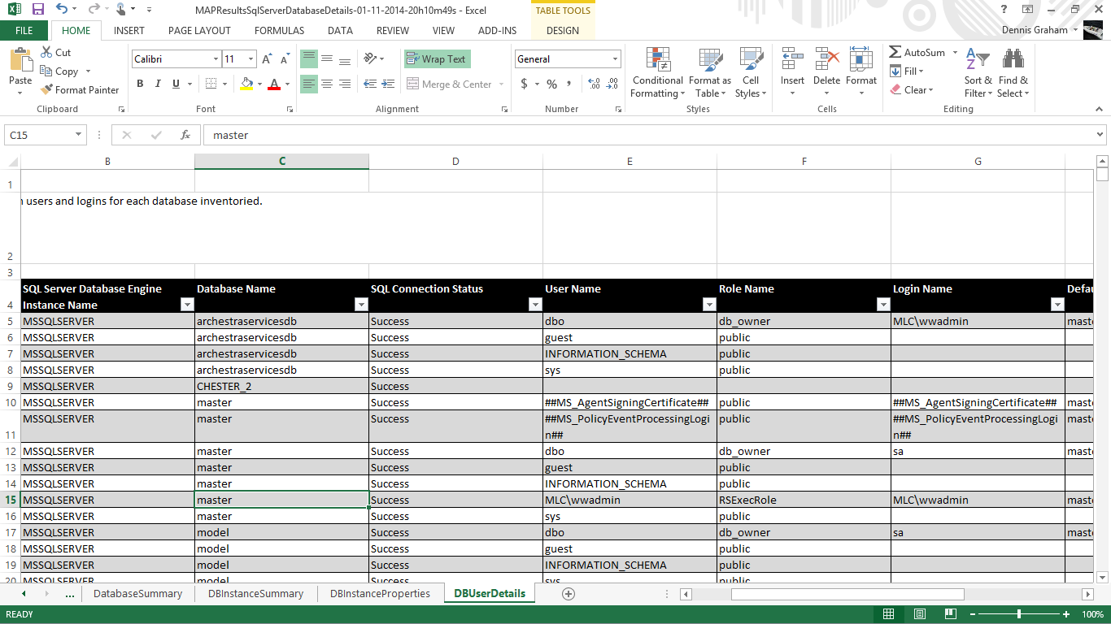
Microsoft Assessment and Planning (MAP) Toolkit

Slide 15
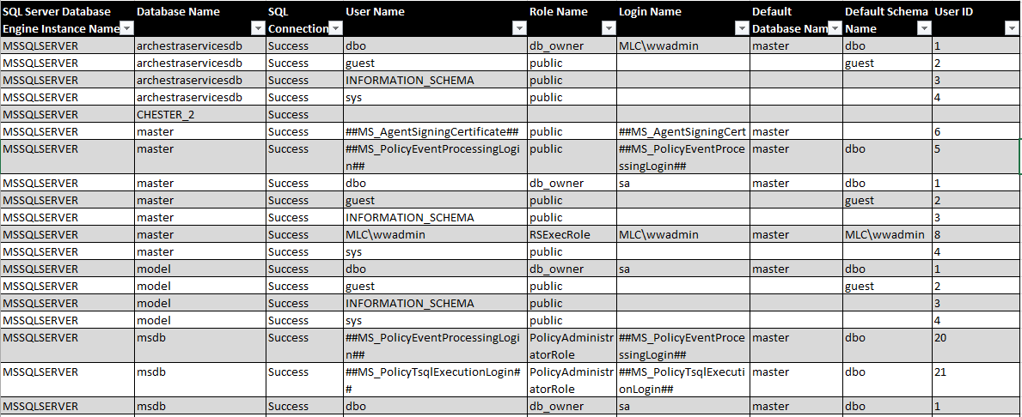
Microsoft Assessment and Planning (MAP) Toolkit

Slide 16
SP_Blitz
Priority | FindingsGroup |  | Finding | DatabaseName | URL | Details
0 | Oct 12 2013 |  |  | NULL
1 | Backup | Backing Up to Same Drive Where Databases Reside |  | NULL | http://BrentOzar.com/go/backup | Drive G:\ houses both database files AND backups taken in the last two weeks. This represents a serious risk if that array fails.
1 | Backup | Backups Not Performed Recently |  | AcmeDB | http://BrentOzar.com/go/nobak | Database AcmeDB never backed up.
1 | Backup | Backups Not Performed Recently |  | AcmeEmployees | http://BrentOzar.com/go/nobak | Database AcmeEmployees never backed up.
1 | Backup | Backups Not Performed Recently |  | LIMS | http://BrentOzar.com/go/nobak | Database LIMS never backed up.
1 | Backup | Backups Not Performed Recently |  | master | http://BrentOzar.com/go/nobak | Database master never backed up.
1 | Backup | Backups Not Performed Recently |  | model | http://BrentOzar.com/go/nobak | Database model never backed up.
1 | Backup | Backups Not Performed Recently |  | msdb | http://BrentOzar.com/go/nobak | Database msdb never backed up.
1 | Backup | Full Recovery Mode w/o Log Backups |  | AcmeDB | http://BrentOzar.com/go/biglogs | Database AcmeDB is in FULL recovery mode but has not had a log backup in the last week.
1 | Backup | Full Recovery Mode w/o Log Backups |  | AcmeEmployees | http://BrentOzar.com/go/biglogs | Database AcmeEmployees is in FULL recovery mode but has not had a log backup in the last week.
1 | Performance | Memory Dangerously Low |  | NULL | http://BrentOzar.com/go/max | The server has 12277 megabytes of physical memory, but only 144 megabytes are available. As the server runs out of memory, there is danger of swapping to disk, which will kill performance.
10 | Security | Sysadmins |  | NULL | http://BrentOzar.com/go/sa | Login [WileE] is a sysadmin - meaning they can do absolutely anything in SQL Server, including dropping databases or hiding their tracks.
20 | Reliability | System Database on C Drive |  | master | http://BrentOzar.com/go/cdrive | The master database has a file on the C drive. Putting system databases on the C drive runs the risk of crashing the server when it runs out of space.
20 | Reliability | System Database on C Drive |  | model | http://BrentOzar.com/go/cdrive | The model database has a file on the C drive. Putting system databases on the C drive runs the risk of crashing the server when it runs out of space.
50 | Reliability | Agent Jobs Without Failure Emails |  | NULL | http://BrentOzar.com/go/alerts | The job Aggregate Data SQLdmRepository has not been set up to notify an operator if it fails.
50 | Reliability | Last good DBCC CHECKDB over 2 weeks old |  | EAMPROD | http://BrentOzar.com/go/checkdb | Database [AcmeDB] last had a successful DBCC CHECKDB run on 2010-12-01 20:00:05.523. This check should be run regularly to catch any database corruption as soon as possible. Note: you can restore a backup of a busy production database to a test server and run DBCC CHECKDB against that to minimize impact. If you do that, you can ignore this warning.
100 | Performance | Slow Storage Writes on Drive C |  | NULL | http://BrentOzar.com/go/slow | Writes are averaging longer than 20ms for at least one database on this drive. For specific database file speeds, run the query from the information link.

Slide 17
Ola Hallengren
EXECUTE dbo.IndexOptimize @Databases = 'USER_DATABASES', @FragmentationLow = NULL, @FragmentationMedium = 'INDEX_REORGANIZE,INDEX_REBUILD_ONLINE,INDEX_REBUILD_OFFLINE', @FragmentationHigh = 'INDEX_REBUILD_ONLINE,INDEX_REBUILD_OFFLINE',
@PageCountLevel = ‘1000’ @FragmentationLevel1 = 5, @FragmentationLevel2 = 30
EXECUTE dbo.DatabaseBackup @Databases = 'USER_DATABASES', @Directory = 'C:\Backup', @BackupType = 'FULL', @Verify = 'Y', @Compress = 'Y', @CheckSum = 'Y',
@LogToTable = ‘Y’
@CleanupTime = 24

Slide 18

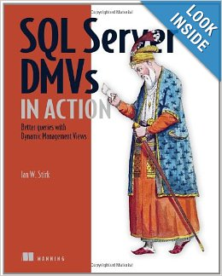
DMV Queries
Michael J Swart
Top 20 Executed Queries
SQL Server DMVs in Action: Better Queries with Dynamic Management Views
By Ian W. Stirk
Performance Tuning with SQL Server Dynamic Management Views
by Tim Ford and Louis Davidson
Notes:
SELECT TOP 10 SUBSTRING(qt.TEXT, (qs.statement_start_offset/2)+1, ((CASE qs.statement_end_offset WHEN -1 THEN DATALENGTH(qt.TEXT) ELSE qs.statement_end_offset END - qs.statement_start_offset)/2)+1), qs.execution_count, qs.total_logical_reads, qs.last_logical_reads, qs.total_logical_writes, qs.last_logical_writes, qs.total_worker_time, qs.last_worker_time, qs.total_elapsed_time/1000000 total_elapsed_time_in_S, qs.last_elapsed_time/1000000 last_elapsed_time_in_S, qs.last_execution_time, qp.query_plan FROM sys.dm_exec_query_stats qs CROSS APPLY sys.dm_exec_sql_text(qs.sql_handle) qt CROSS APPLY sys.dm_exec_query_plan(qs.plan_handle) qp ORDER BY qs.total_logical_reads DESC -- logical reads -- ORDER BY qs.total_logical_writes DESC -- logical writes -- ORDER BY qs.total_worker_time DESC -- CPU time

Slide 19
Resources
SQL 2014: Built in
SQL 2012: http://www.microsoft.com/en-us/download/details.aspx?id=29063
http://www.mssqltips.com/sqlservertip/2670/install-sql-server-2012-performance-dashboard-reports/
SQL 2008: http://blogs.technet.com/b/rob/archive/2010/09/28/hosting-the-performance-dashboard-reports-in-ssrs.aspx
SQL 2005: http://www.microsoft.com/en-us/download/details.aspx?DisplayLang=en&id=22602
Hosting the Performance Dashboard Reports in SSRS http://blogs.technet.com/b/rob/archive/2010/09/28/hosting-the-performance-dashboard-reports-in-ssrs.aspx
Sp_Blitz: http://www.brentozar.com/blitz/documentation/
Perfmon Counters Poster: http://www.quest.com/backstage/images/promotions/SQLServer-Perfmonance-Poster.pdf
Top 20: http://michaeljswart.com/2013/09/my-queries-for-top-20-resource-hogs/
DMV e-book http://www.manning.com/stirk/DMViACH01FREE.pdf
DMV e-book http://download.red-gate.com/ebooks/SQL/eBook_Performance_Tuning_Davidson_Ford.pdf

Slide 20

Dennis Graham
dennis.e.graham@hotmail.com

